Slide 1


Solving 1 || ∑T_{i}
Progetto per il Corso di Algoritmi e Modelli per l’Ottimizzazione Discreta
A.A. 2021 2022
D’Amico Danilo

Slide 2

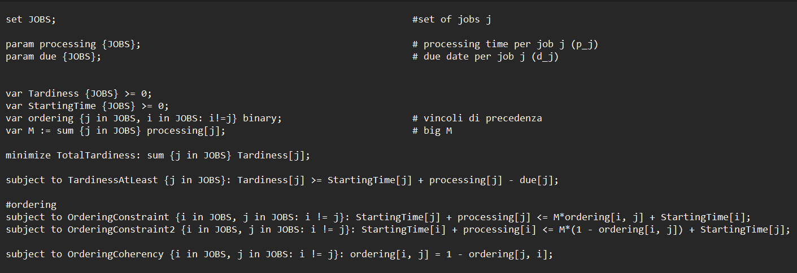
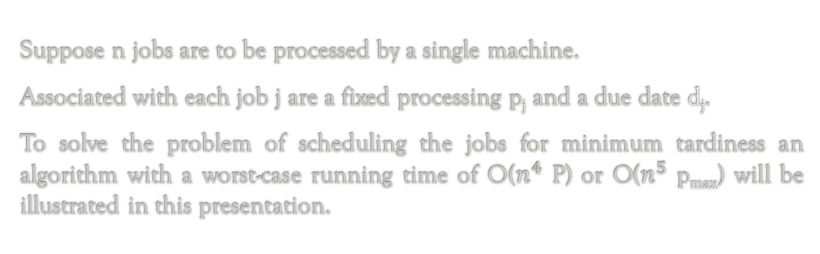
Problem Description
Suppose n jobs are to be processed by a single machine.
Associated with each job j are a fixed processing p_{j} and a due date d_{j}.
To solve the problem of scheduling the jobs for minimum tardiness an algorithm with a worst-case running time of O($n^{4}$ P) or O($n^{5}$ p_{max}) will be illustrated in this presentation.

Slide 3
Theorem 1
Let ∏ be an optimal sequence for the problem.
Let C_{j} and d_{j} the completion time and due date for job j respectively.
Chose d’_{j} such that:
min(d_{j} , C_{j} ) ≤ d’_{j} ≤ max(d_{j} , C_{j} )
Any sequence ∏’ optimal with respect to the new due dates is also optimal for the original ones

Slide 4
Theorem 2
There is an optimal sequence ∏ in which job i precedes job j if
d_{i} ≤ d_{j} AND p_{i} ≤ p_{j}
And in which all on time jobs are in nondecreasing deadline order

Slide 5
Theorem 3
Suppose the jobs are numbered in non-decreasing deadline order.
Let job k be such that p_{k} = max_{j}{p_{j}}
Then there is some integer 0 ≤ ∂ ≤ n – k such that ∃ optimal sequence ∏ in k which k is preceded by all jobs j such that j ≤ k + ∂ and followed by all jobs such that j > k + ∂.

Slide 6
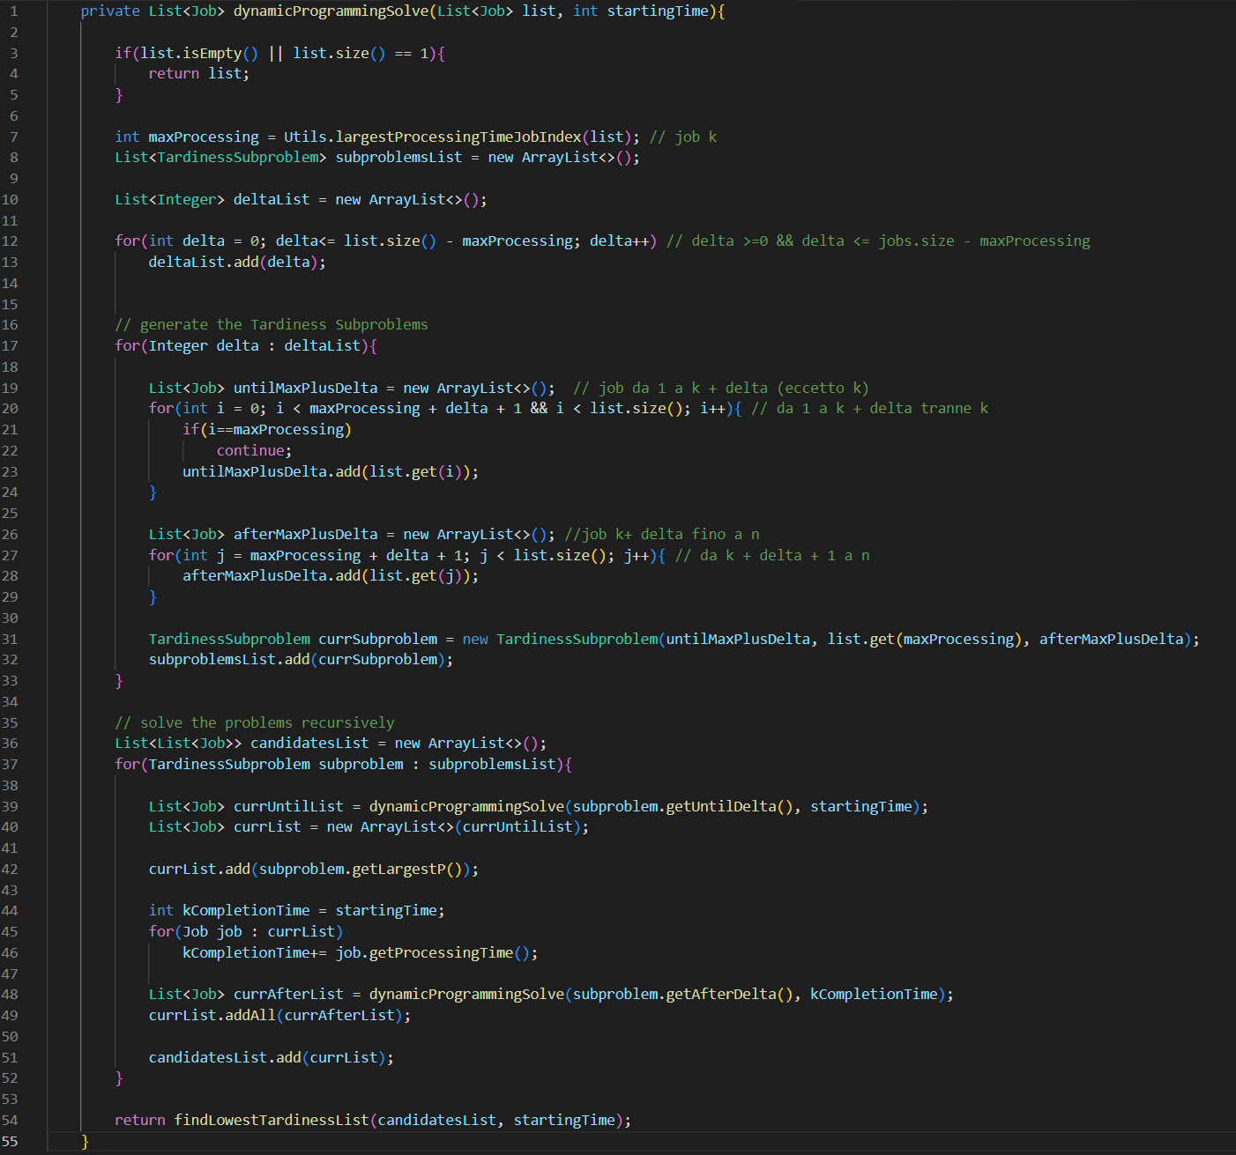
Dynamic Programming Solution
Assume the jobs ordered in non-decreasing deadline order.
There exists an optimal sequence in the form of:
jobs 1, … k + ∂ (excluding k)
job k
the remaining jobs
The sequence is optimal only if the subsequences are optimal

Slide 7
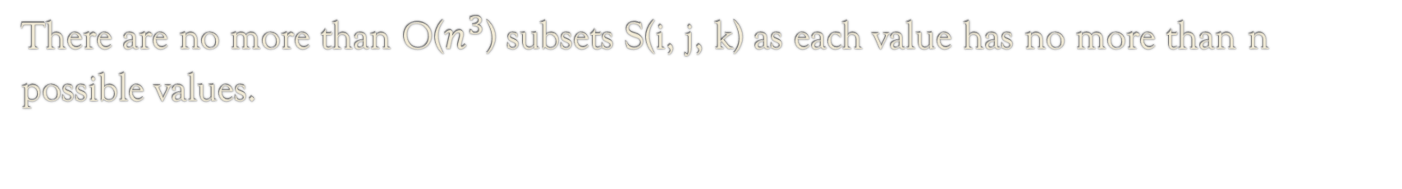
Cost Computation
Let’s denote any subset S identified by the algorithm by
S(i, j, k)
k is the job with the highest processing time identified at the creation of the subsets
S contains the jobs in interval i,j
There are no more than O($n^{3}$) subsets S(i, j, k) as each value has no more than n possible values.

Slide 8
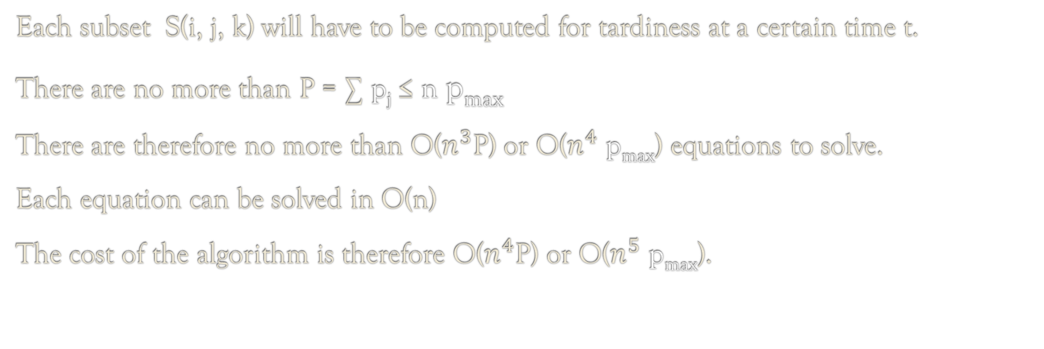
Cost Computation
Each subset S(i, j, k) will have to be computed for tardiness at a certain time t.
There are no more than P = ∑ p_{j} ≤ n p_{max}
There are therefore no more than O($n^{3}$P) or O($n^{4}$ p_{max}) equations to solve.
Each equation can be solved in O(n)
The cost of the algorithm is therefore O($n^{4}$P) or O($n^{5}$ p_{max}).

Slide 9
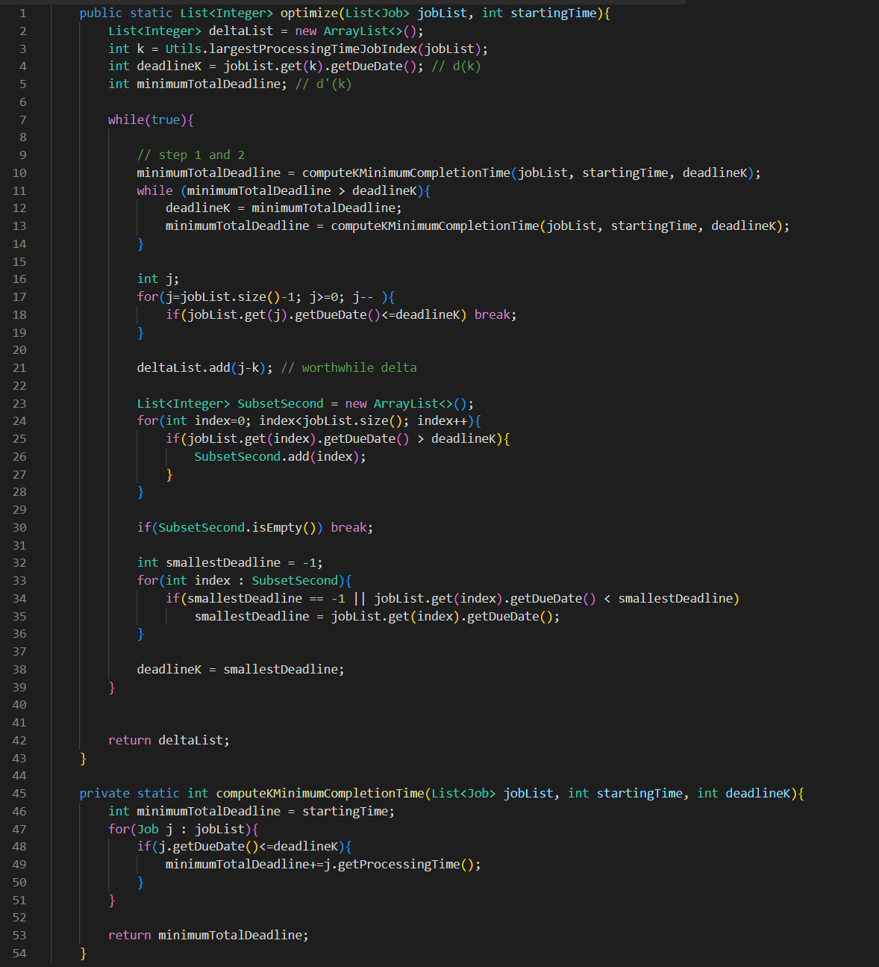
Delta Optimization
The values of ∂ the algorithm must examine can be optimized through Theorem 1 and 2.
Theorem 2: if job k has deadline d_{k} there is an optimal sequence in which k completes at least at time minimumTotalDeadline
Theorem 1 ensures the sequence computed for the new deadlines are optimal with respect to the original ones

Slide 10
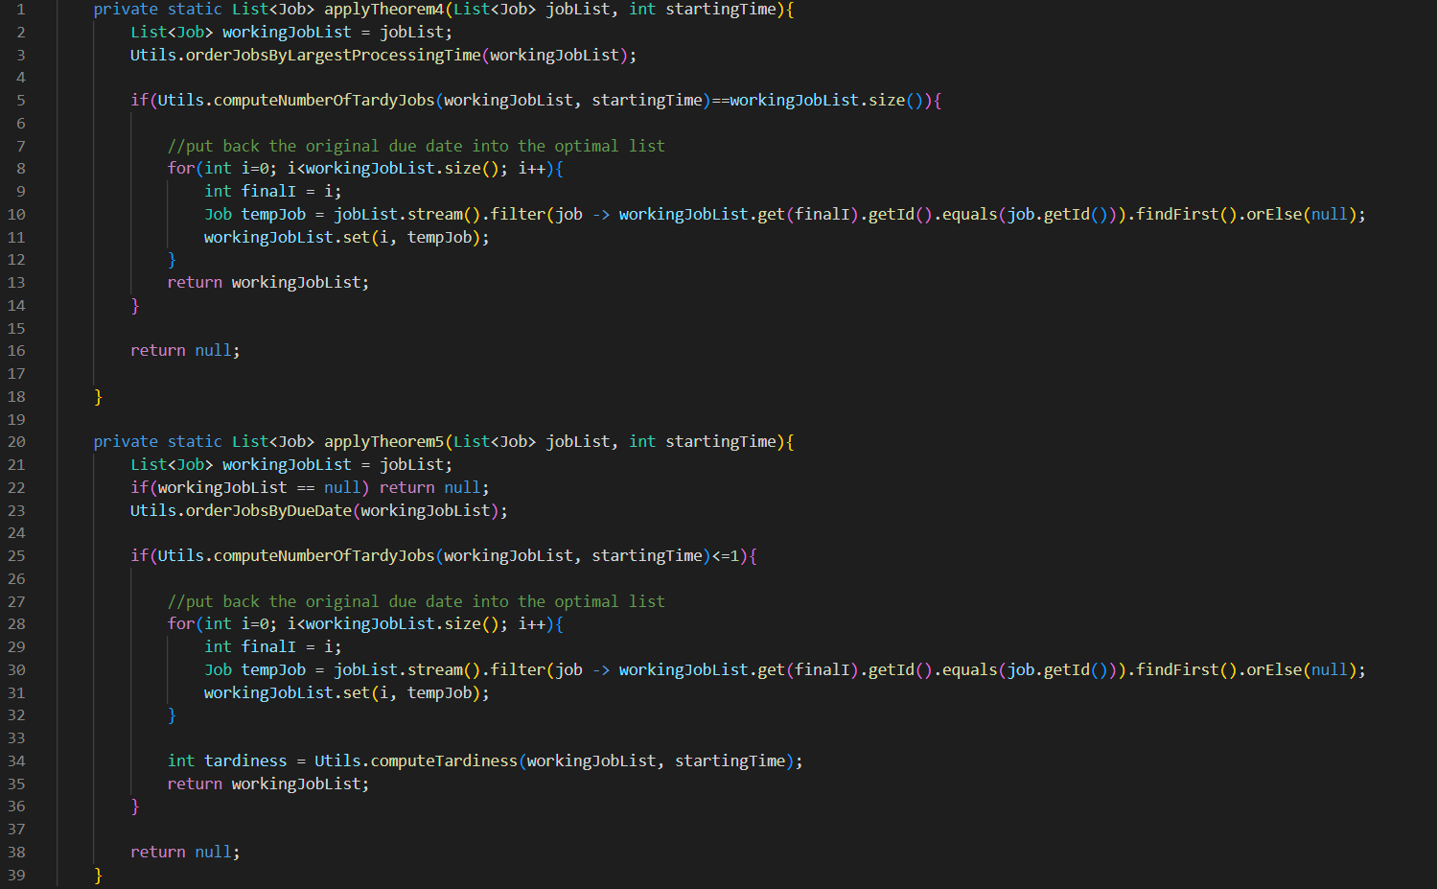
Shortcut Solution
Theorem 4: Let ∏ be a sequence in which jobs are ordered by largest p_{j}.
If all jobs are tardy, then ∏ is optimal.
Theorem 5: Let ∏ be a sequence for which max_{j}{T_{j}} is minimum.
If at most one job is tardy, then ∏ is optimal

Slide 11
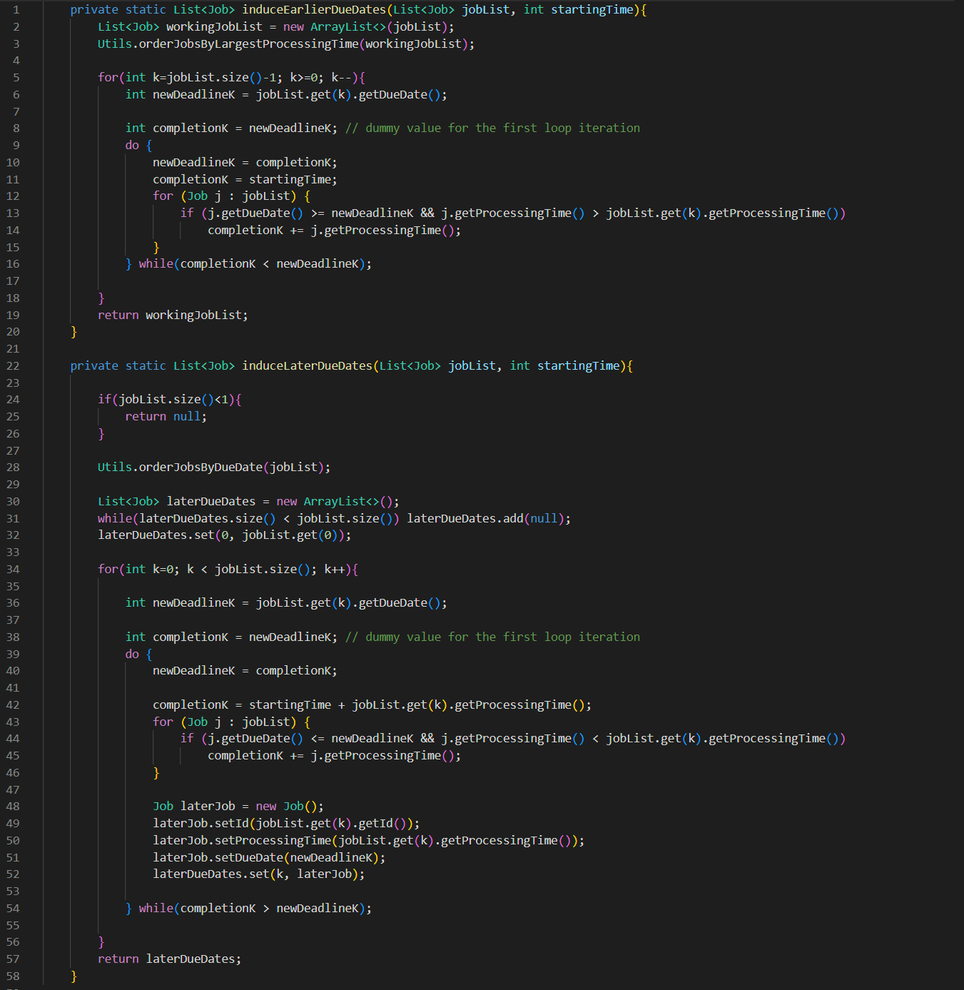
Shortcut Solution
As per Theorem 1, we can induce later or earlier due dates to improve the effectiveness of Theorem 4 and 5

Slide 12
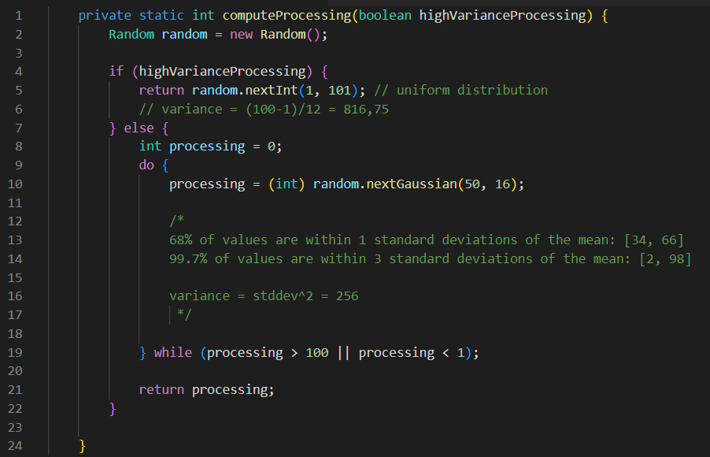
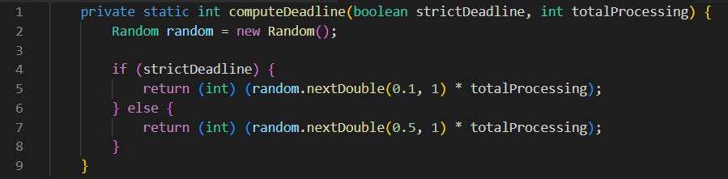
Pseudorandom Experiments
To test the real-world performance of the algorithm and its implementation, the project includes code to generate 200 problems for each of four types of problems. The four types are combinations of two different sets of processing times and deadlines:

Slide 13

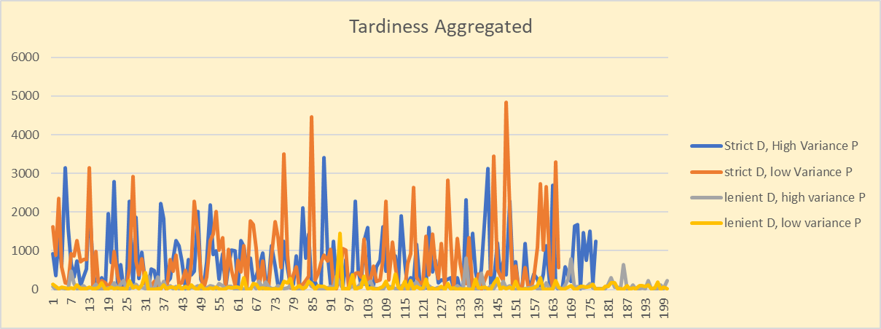
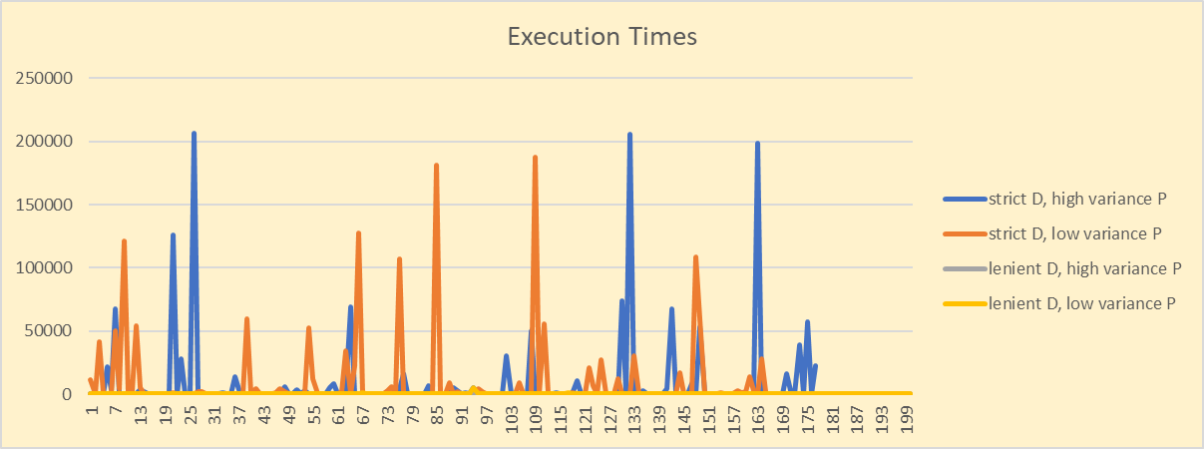
Pseudorandom Experiments
The results are available in the attached .xlsx document. They are computed over 60-job problems and a 5 minutes timeout.
The duration of simulations is reported in milliseconds.
The graphs show that the variance of the processing time is not a variable that dramatically changes the time needed to compute the solution.
On the other hand, a restriction on the possible values of the deadline has an enormous effect on the complexity of the problem

Slide 14
Pseudorandom Experiments
Looking at the data relative to completion, it can be concluded that stricter deadlines reduce the number of simulations so short that Java considers them 0-milliseconds long and increases the percentage of Simulations that do not complete on time

Slide 15
Bibliography
Eugene L. Lawler, A “pseudo polynomial” algorithm for sequencing jobs to minimize total tardiness, Ann. of Discrete Math., 1:331-342, 1977.
J. Du and J.Y.-T. Leung, Minimizing total tardiness on one machine is NP-hard, Math. Oper. Res., 15(3):483-495, 1990.

